Slide 1
The Influence of Dynamic Visual Scene Statistics on Pupil Size
Peter Hanson
DISTRIBUTION STATEMENT GOES HERE
Graduate Student, University of Texas, El Paso
Research Intern, ARL West
28 07 2020

Slide 2


Army relevance
Human Agent Teaming (HAT) Essential Research Program
We want to understand how we can leverage a common physiological sensor (eye tracking) to predict mental states while soldiers are engaged in realistic tasks (free navigation) within a complex environment or real-world operation.
We believe pupillometry can serve as a useful and effective data source for adaptive future technologies, specifically, in predicting mental states related to arousal, mental load, stress and attention (Cohen Hoffing & Thurman, 2020).
Hoffing, R. A. C., Thurman, S. M. (2020). The State of the Pupil: Moving Toward Enabling Real-World Use of Pupillometry-Based Estimation of Human States. ARL-TR-8947.

Slide 3
BACKGROUND
We know that pupil size is influenced by cognitive factors (mental workload, attention, decision making) (Cohen Hoffing et al., 2020)
However, pupil size is also influenced by non-cognitive factors (luminance, vergence) (for review see Mathot, 2018).
This project aims to develop better models to account for luminance-based changes in pupil size while subjects navigate a complex 3D virtual environment.
Hypothesis: If we can better account for non-cognitive influences, then it will help us to factor these out to improve estimation of cognitive-linked pupil response for real-world applications.
Hoffing, R. A. C., Lauharatanahirun, N., Forster, D. E., Garcia, J. O., Vettel, J. M., & Thurman, S. M. (2020). Dissociable mappings of tonic and phasic pupillary features onto cognitive processes involved in mental arithmetic. PloS one, 15(3), e0230517.
Mathôt, S. (2018). Pupillometry: Psychology, physiology, and function. Journal of Cognition, 1(1).

Slide 4
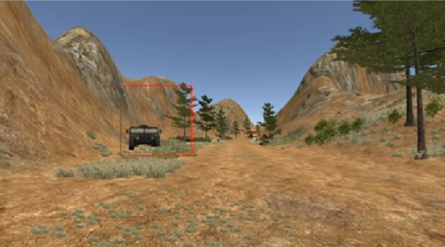


Human Interest Detector (HID) Experiment
35 subjects
TASK: Navigate a virtual environment and search for target objects (i.e. Helicopters, humvees, etc).
Used mouse and keyboard to navigate
Total duration was about 12 minutes
Collected eye tracking: gaze position and pupil size
RESEARCH QUESTION: How well do RGB pixel intensities explain variations in pupil size?
APPROACH: Examine the inter-relationship between RGB scene statistics, luminance measurements, and pupil dynamics over time

Slide 5
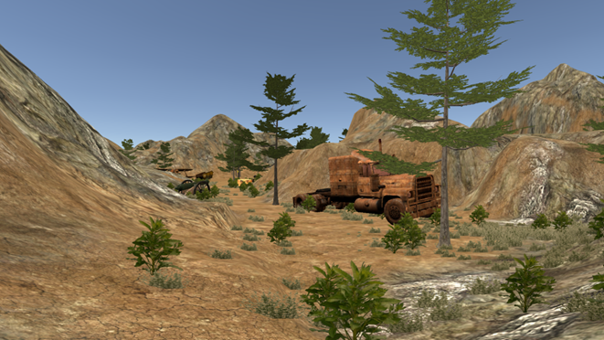
Overall Project Goals
1. Generate a sequence of “snapshots” for each subject by using software to replay their session (post-hoc), and then saving images
2. Use a photospectrometer to collect data from the laboratory to convert RGB intensities to units of luminance (cd/m^2)
3. Model the relationship between variations in luminance and the expected change in pupil size (Korn & Bach, 2016)
4. Analyze how RGB intensities influence pupil size using 2 approaches
a. Foveal Windows approach
b. Pixel-by-pixel correlation maps
Korn, C. W., & Bach, D. R. (2016). A solid frame for the window on cognition: Modeling event-related pupil responses. Journal of Vision, 16(3), 28-28.
Notes:
This project has 4 primary goals that include:
First we had to generate a sequence of snapshots for each subject by replaying their navigation through the environment from a log file and saving the images.
Next we used a photospectrometer to measure screen luminance to enable us to map RGB intensity values to luminance space, which is measured in candelas per meter squared
Then we implemented a model from the literature that predicts pupil size as a result of luminance changes by accounting for the common shape and sluggishness of the pupil response to light
Finally, we examined correlations between the predicted pupil response and actual pupil size measurements throughout the 12 minute navigation task.
We used a foveal windows approach that examined mean luminance within various sized windows surrounding the point of gaze.
We also used a pixel-by-pixel approach to generate correlation maps that represent the relationship between pupil size and luminance for every pixel surrounding the gaze point.

Slide 6
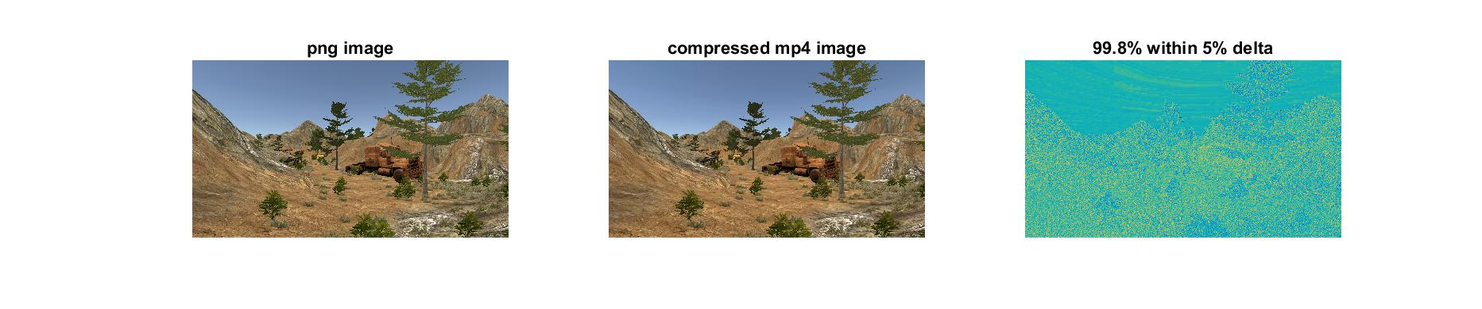
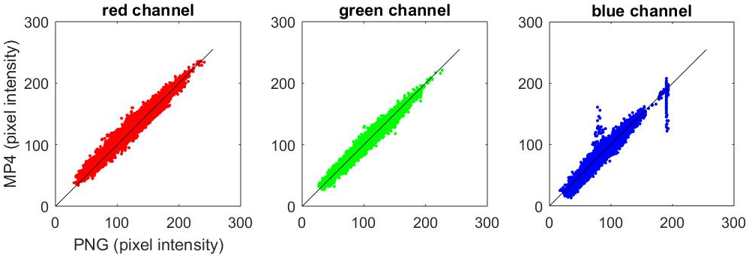
Creating and Storing Snapshots
Each subject had ~80k snapshots (png images) taking up 200gb
To reduce storage space (to ~2gb), we used mp4 video compression
We compared mp4 images to the original png images to ensure this didn’t introduce too many artifacts
Bland Altman analysis
RED
bias = 0.7
95% COR= 12.1
GREEN
bias = -0.8
95% COR = 8.0
BLUE
bias = -0.4
95% COR = 13.6
Notes:
Our first challenge in this project was related to storage space. The snapshot generator software created around 80 thousand png images for the 12 minute task, and this amounted to 200 gigabytes per subject.
We decided to compress the sequence of images as a movie using an mp4 encoder in matlab, which achieved a hundred-fold decrease in storage space down to about 2 gigabytes per subject.
However, we had to ensure that the video encoder didn’t introduce too many artifacts.
Visually these two example images look the same with minor differences visible in the difference image on the right
Importantly, bland altman analysis of png and mp4 pixel intensities revealed that 95% of differences fell within a range of 8-13, depending on the color channel.
Since the entire 8-bit color intensity space has 256 levels, this implies that 95% of pixel-wise differences were within a range of 5% of the full color range, We considered this an acceptable level of compression artifacts to trade off with the enormous reduction in storage space.

Slide 7
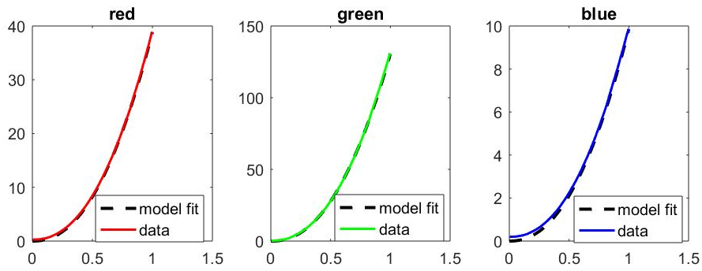
Converting RGB to Luminance
We used a photospectrometer to measure luminance across the entire range from 0 (min) to 255 (max) for each color channel seperately
We fit the data with an exponential function to derive a gamma parameter that non-linearly maps RGB intensities to luminance space
E.g. this is the typical procedure for gamma-correcting a monitor
Gamma=2.24
Gamma=2.23
Gamma=2.22
Luminance (cd/m^2)
Normalized intensity
Notes:
I won’t spend too much time on this because this data was collected by one of my mentors because was the one with access to the laboratory this summer.
What he did was use a photospectrometer to measure the luminance of each color channel across the spectrum of pixel intensities from 0 to 255.
He fit this data with an exponential function to derive a gamma parameter to describes the non-linear transformation from pixel intensity space to luminance space.
I will note that the gamma values are close to 2.2, which is a standard or common value for most computer monitors.
I used this function to convert RGB channels into luminance space prior to subsequent analyses.

Slide 8
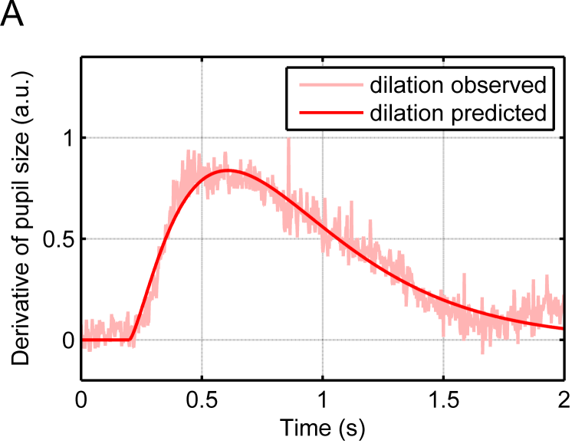
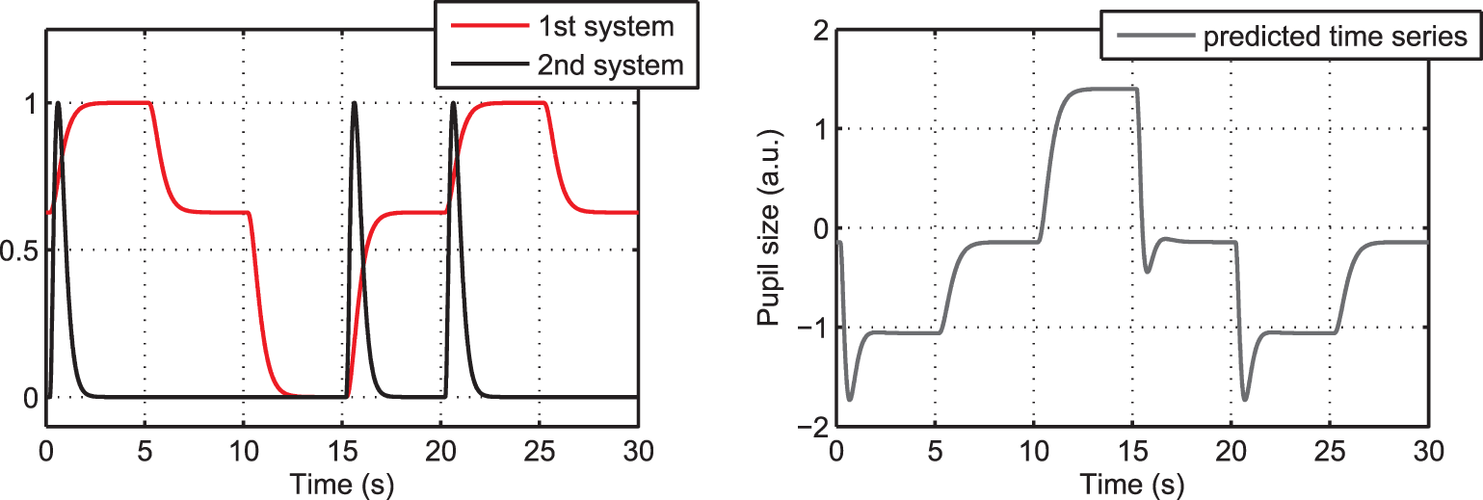
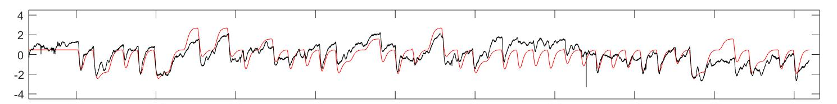
Pupillary light response (PLR) model
We modeled the pupil light response as a function of luminance dynamics using a classic approach of convolving with a gamma pdf
accounts for sluggishness and canonical shape of pupil light response
As suggested by Korn & Bach (2016), we separately model the rapid constrictions resulting from sudden luminance increases (2nd system)
E.g. this model has fit well to data in our lab using a very simple task
IMAGES FROM: Korn, C. W., & Bach, D. R. (2016). A solid frame for the window on cognition: Modeling event-related pupil responses. Journal of Vision, 16(3), 28-28.
Pupil size
PLR model
Notes:
We could have computed correlations between raw luminance and pupil size, but this would fail to account for the well-known shape and sluggishness of the pupil response to light.
Consistent with most models in the literature, we convoved the luminance signal with a gamma probability density function, as pictured in the image on the left, with a time delay of 666 milliseconds.
So the pupil constricts in response to an increase in luminance, and it dilates when there is a decrease in luminance, but the speed of the constriction response is actually much faster than the dilation response.
To account for this, following the suggestion from a study by Korn and Bach in 2016, we modeled an additional constriction response for cases in which the luminance increased.
I will note in the bottom graph that this model fits data quite well for a basic task with controlled changes in screen brightness that we performed in the laboratory.
We applied this model to the patterns of luminance in our rich, 3D environment to examine correlations with pupil size.

Slide 9
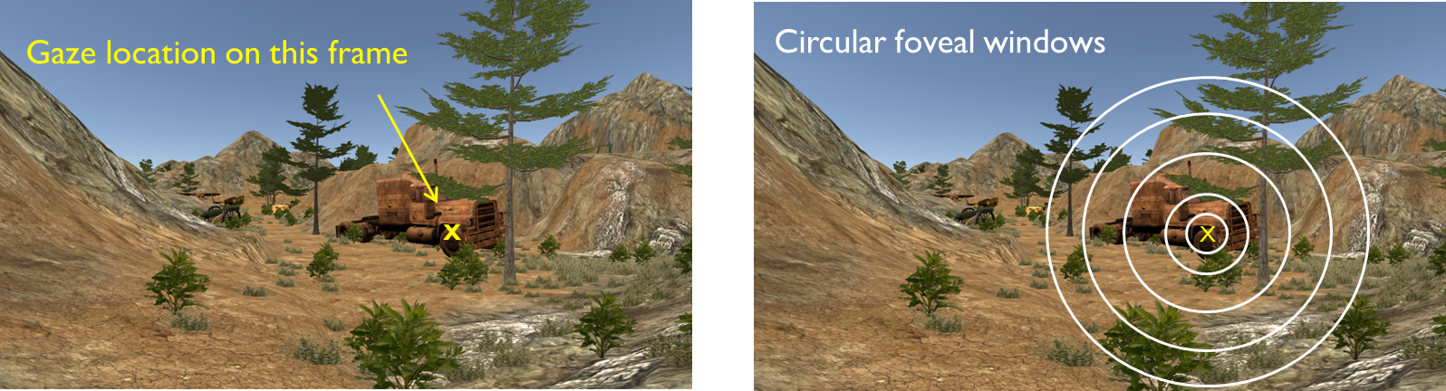
Foveal Windows Approach
In this approach we took different sized windows to see how mean luminance in R, G, B channels affects the subject’s pupil size.
Sizes of windows: 50, 150, 300, 500, 700 pixels, and “Full Frame”
We first applied PLR model to mean luminance, then examined the correlation with pupil as a function of window size

Slide 10
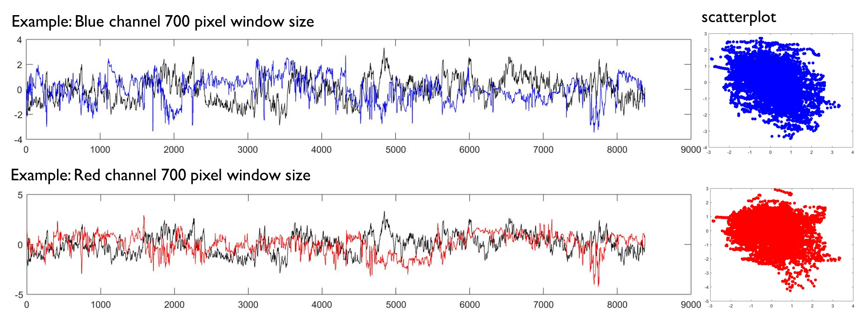
Analysis: Correlation coefficients

Slide 11
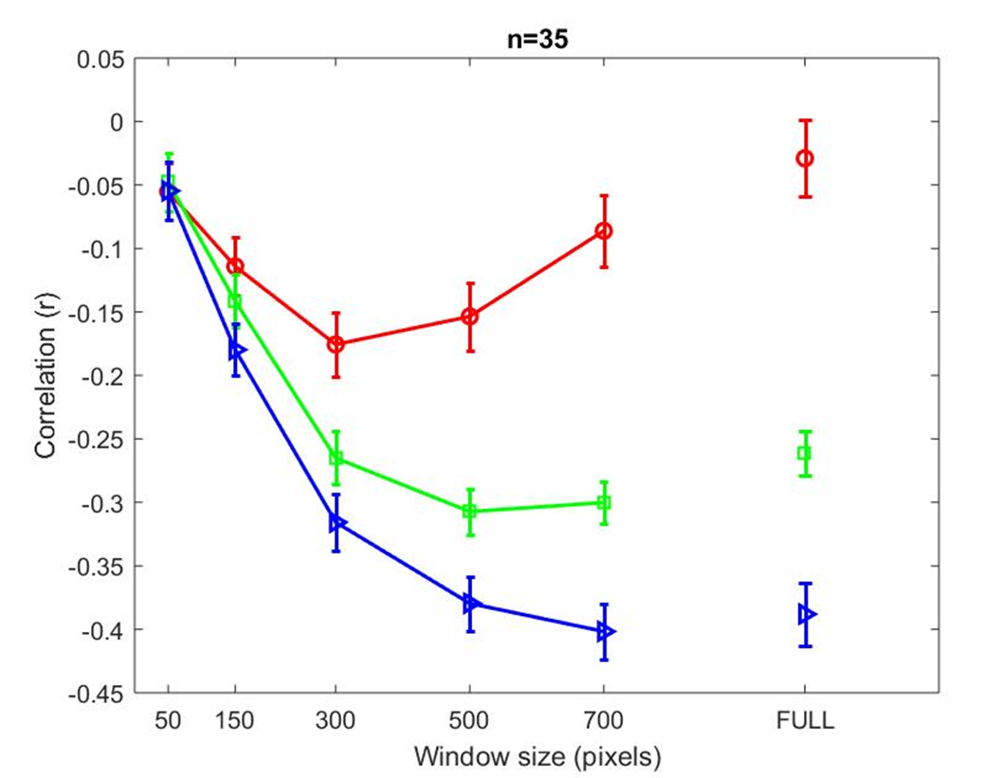
Group RESULTS
Blue channel was most strongly negatively correlated
Larger windows (700+ pixels) had strongest relationship
Green channel followed a similar pattern
Red channel least strongly correlated
Intermediate windows (300 pixels) had strongest relationship

Slide 12
Pixel-by-Pixel Correlation maps
The foveal window approach makes the assumption that ALL pixels near fixation contribute EQUALLY to pupil size fluctuations
Using a pixel-by-pixel approach, we can assess if this is true or not.
If not true, then we can DISCOVER more detailed spatial maps of how pixels near fixation actually influence pupil size.
e.g. lower contribution outside the foveal window
Assumes equal contribution within the circular foveal window
gaze point

Slide 13
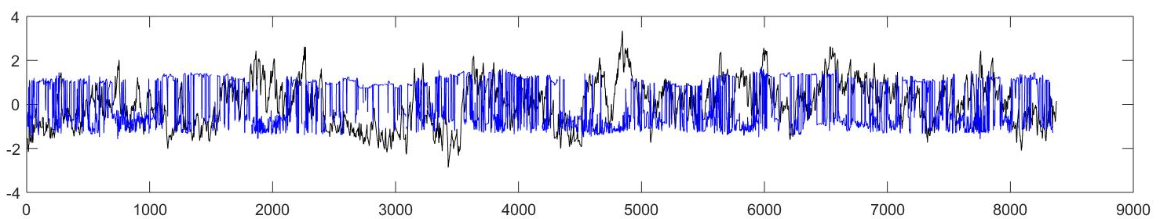
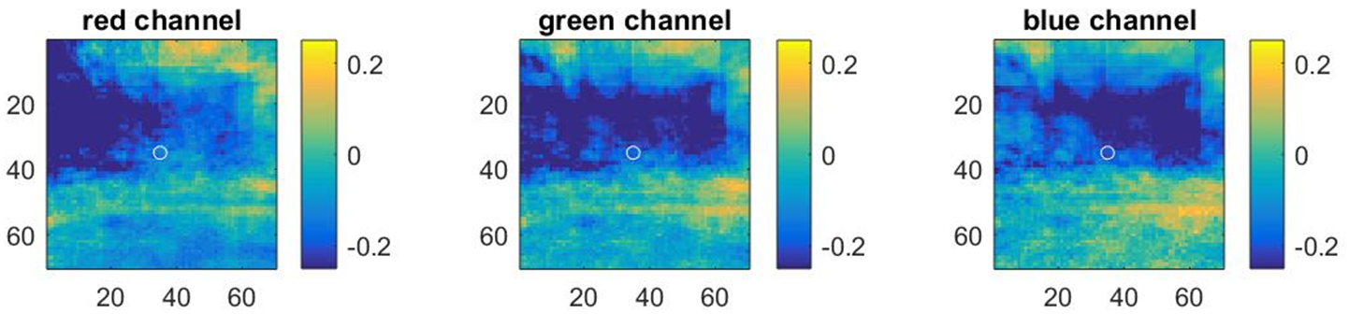
Example correlation map Results
Correlation maps for a single example subject
Inset shows time series for one pixel in the blue channel

Slide 14
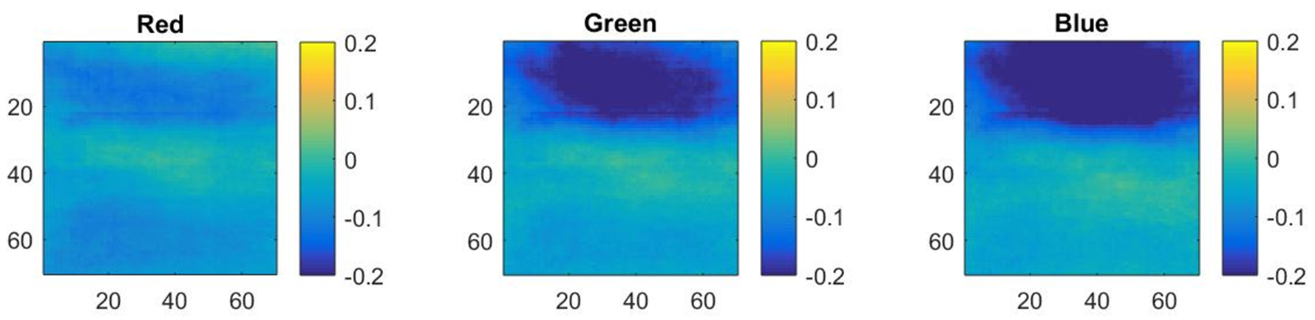
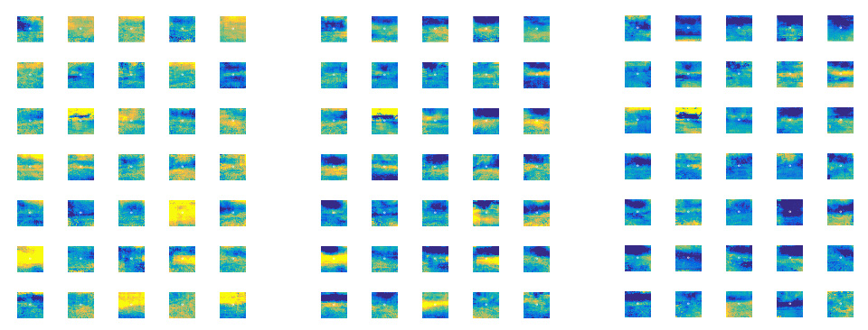
Group Maps (individual subjects below)
Blue sky effect?

Slide 15
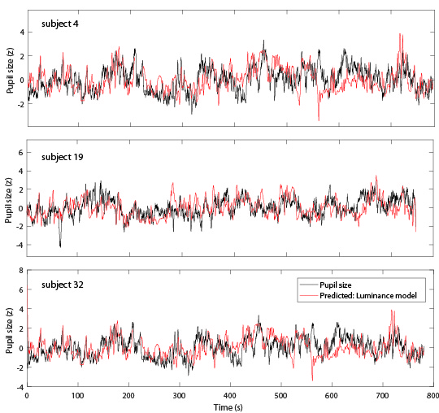
Ability to predict pupil size
r = -0.37
Some examples showing how well this model of RGB statisitics can predict pupil size:
r = -0.43
r = -0.41
Notes:
Finally, the end result of this work is an optimized model to predict pupil size based solely on luminance changes. For the 3 example subjects shown here, there is a very strong negative correlation between pupil size and the model prediction.
The model captures some of the shorter timescale changes and many of the longer timescale changes in pupil size
You can also see that there are deviations from the model at some time points.
This is actually important because we hypothesize that these deviations may be functionally important and related to the influence of ongoing cognitive processes, because we know that luminance is just one of several possible contributors to pupil size.
By subtracting the predicted luminance signal out, we can possibly arrive at a better estimate of pupil-linked cognitive processes, which further research will help determine.

Slide 16
Conclusions
There is a strong negative correlation between pupil size and the intensity of RGB scene statistics
Based on the results from the foveal window approach we can conclude that when it comes to window sizes:
Larger window sizes better capture influence of blue and green channels
Intermediate window sizes better captures the influence of the red channel
Based on the results from the pixel-by-pixel approach we can conclude that for the green and blue pixel channels:
The strongest correlation is for pixels just above the point of gaze
We hypothesize this is a result of the blue sky in this task environment
Overall the results have helped in our understanding of how scene statistics should be analyzed in complex scenes to best predict pupil size fluctuations caused by light.

Slide 17
Future work
We wonder if these results would generalize to real-world images or other environments, or is the hypothesized “blue sky” effect specific to this task?
Can we use this new knowledge to develop a better model of pupil changes from scene statistics in this task, and thereby improve our ability to estimate cognitive effects (e.g. Target detections)?
How do other scene statistics interact with RGB intensity to influence on pupil size?
The properties (specifically) of fixated objects vs. other scene elements
Global level of environmental brightness / darkness

